Slide 1

Drone detection using YOLOv8
Team members:
1.Koushik
2.Adithya
3.Chandra Gupta

Slide 2

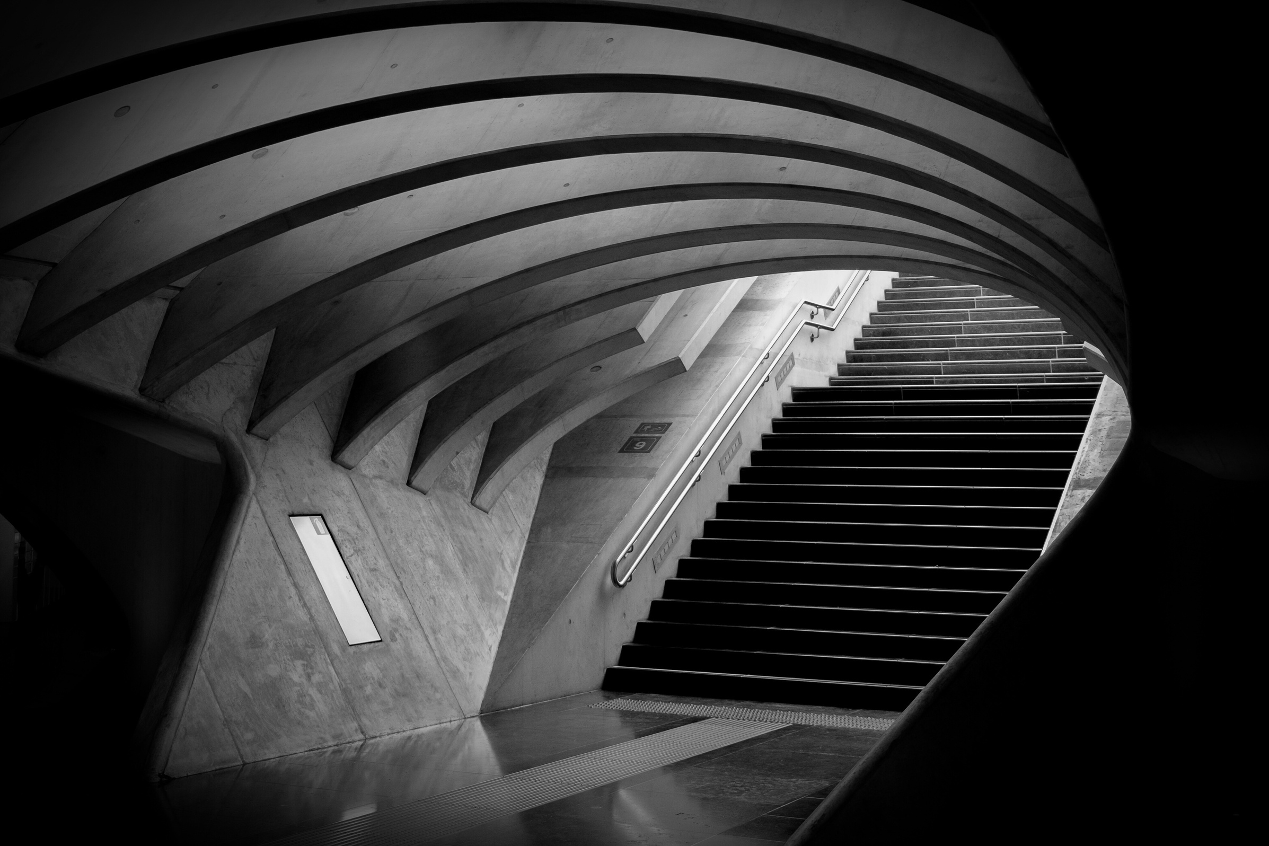
Abstract
As drones are being employed more and more for military and commercial purposes, drone detection research has grown in importance. Conversely, drones can be used for illegal monitoring, reconnaissance, or even to attack individuals or property. Drones can be identified and tracked by anti-drone systems, which keeps them out of areas where they could endanger people's safety. Generally speaking, an anti-drone system makes sure that drones are detected, classified, and neutralized. The inability of conventional detection techniques, including radar and acoustic sensors, to identify small, low-flying drones has forced the creation of novel solutions. Machine learning (ML) algorithms have become a potential solution for drone identification and classification due to their accuracy and efficiency in detecting drones in a range of scenarios.

Slide 3

Objective
We are implementing a drone detection system using the YOLOv8 technique, the primary objective is to accurately identify and categorize drones within given imagery. The process involves data collection, annotation, and preprocessing. We choose YOLOv8 as the foundational architecture and refine it using a drone dataset that has been annotated. Confidence thresholding and non-maximum suppression are examples of post-processing procedures. Metrics like precision and recall are used to assess the performance of the model. After training, the model is used for inference in real time, and continuous monitoring ensures that it can identify drones.

Slide 4
Literature Survey
M. Sliti and M. Garai, "Drone Detection and Classification approaches based on ML algorithms," 2023 28th Asia Pacific Conference on Communications (APCC), Sydney, Australia, 2023, pp. 195-201, doi: 10.1109/APCC60132.2023.10460666. keywords: {Machine learning algorithms;Surveillance;Radar detection;Radar;Machine learning;Reconnaissance;Radar tracking;Anti drone systems;Drone detection;Drone classification;Machine learning},
Mertis: Using Convolutional Neural Networks (CNN) for drone detection provides a high level of accuracy and efficiency in identifying and classifying drones from images, making it a reliable and effective method for security and surveillance applications.
Demerits :Convolutional Neural Networks (CNN) for drone detection is the high computational resources required for training and processing, which can lead to increased costs and infrastructure demands.’
Conclusion: CNNs remain a viable option for drone detection in scenarios where computational resources are not a limiting factor or can be adequately provided.

Slide 5
.Naveen, H. P. Menon, V. Vinitha, K. R. Vishnuraj, A. Satheesh and A. P. Nikhil, "A Study on YOLOv5 for Drone Detection with Google Colab Training," 2023 2nd International Conference on Automation, Computing and Renewable Systems (ICACRS), Pudukkottai, India, 2023, pp. 1576-1580, doi: 10.1109/ICACRS58579.2023.10404797. keywords: {YOLO;Adaptation models;Computational modeling;Real-time systems;Internet;Reliability;Drones;Object detection;Unmanned Aerial Vehicle (UAVs);Drone detection;OpenCV;Google Colab;Convolutional Neural Network (CNN);You Only Look Once(YOLO);Image Processing},
Method: YOLOv5(You Look Only Once) deep learning algortihm
Merits: Using the YOLOv5 algorithm for drone detection offers the benefits of real-time object detection with high accuracy and efficiency, making it suitable for applications requiring prompt responses. Additionally, the adaptability of YOLOv5 to different datasets and scenarios, along with its integration with Google Colab for enhanced training capabilities, ensures robust performance and reliability in drone detection tasks.
Demerits: One potential drawback of using the YOLOv5 algorithm for drone detection is the need for careful tuning and optimization to account for varying drone sizes and orientations, which can impact the model's performance in detecting drones amidst other flying objects.
Conclusion: The YOLOv5 algorithm, with its efficiency, accuracy, adaptability, and integration capabilities, proves to be a suitable method for drone detection tasks, offering real-time object detection with high precision and reliability. Therefore, this method can be confidently used for developing drone detection systems that require prompt responses and accurate identification of drones among various flying objects.
T. Delleji, H. Fekih and Z. Chtourou, "Deep Learning-based approach for detection and classification of Micro/Mini drones," 2020 4th International Conference on Advanced Systems and Emergent Technologies (IC_ASET), Hammamet, Tunisia, 2020, pp. 332-337, doi: 10.1109/IC_ASET49463.2020.9318281. keywords: {Drones;Object detection;Detectors;Annotations;Training;Task analysis;Computational modeling;micro/mini drone detection;Deep Learning;classification;restricted area},
Method: YOLOv3 (You Only Look Once) deep learning algorithm.
Merits: By utilizing the YOLOv3 deep learning algorithm for drone detection, you can benefit from its robustness, accuracy, and speed, allowing for rapid detection at more than 60 frames per second. Additionally, the method has lower requirements on computer specifications compared to other deep-CNN detectors, making it efficient and effective for real-time drone detection tasks
Demerits: One limitation of using the YOLOv3 deep learning algorithm for drone detection is its occasional deficiency in accurately detecting small and tiny objects, such as micro/mini drones, due to the challenges associated with detecting objects occupying surfaces less than 32 * 32 pixels
Conclusion: In conclusion, the study demonstrates that certain categories of micro/mini drones can be effectively detected and identified using an object detector based on deep neural networks, specifically the upgraded YOLOv3 model.

Slide 6
Existing Work
DroneNet: A deep learning-based method created especially for drone detection is called DroneNet. It detects and tracks drones in video streams by combining CNNs with recurrent neural networks (RNNs). Robust for real-world applications, DroneNet can endure a wide range of climatic conditions and drone orientations.
Faster R-CNN: Drone detection tests have been successfully completed using Faster R-CNN, another well-liked object detection technique. Through the use of CNNs and region proposal networks (RPNs), Faster R-CNN is able to accurately and efficiently identify drones in photos or movies.
Using Transfer Learning for Drone Detection: Transfer learning is utilizing previously trained models and optimizing them for particular applications. Researchers have modified pre-existing CNN architectures, like ResNet and VGG, for drone identification through the application of transfer learning. Through adjusting the models on drone-specific datasets, they achieve good performance even with limited training data.
Drone Detection through Feature Engineering: Certain methods combine human-crafted features and machine learning to detect drones. Shape descriptors, color histograms, and texture features are a few examples of these features. Through the extraction of pertinent features from pictures or videos, these techniques can effectively distinguish drones from other objects by applying classifiers like random forests or support vector machines (SVMs).

Slide 7
Proposed Work
Prepare the Data and Upload to Google Drive:
Getting the drone image datasets from the roboflow.
Organize the dataset into the specified folder structure: create subfolders named “train” and “valid” within the “images” and “labels” directories.
Compress the dataset into a zip file and upload it to your Google Drive.
Set Up Google Colab:
Google Colab provides free access to GPU resources. Mount your Google Drive to access your data and store results.
Install Required Libraries:
Install necessary libraries, including Ultralytics for YOLOv8 and GPU information.
Train the YOLOv8 Model:
Create a data.yaml file specifying your dataset and model configuration.
Initiate training using your data with YOLOv8.
Perform Real-Time Drone Detection:
Load the trained YOLOv8 model.
Predicted results will be saved in the directory path:

Slide 8
Conclusion
In conclusion, this study has demonstrated the efficacy of using YOLOv8 for drone detection, addressing the growing need for robust surveillance systems in various sectors. By leveraging deep learning techniques, particularly the YOLOv8 architecture, we have achieved significant advancements in the accuracy and speed of drone detection, enabling timely responses to potential security threats.
FUTURE WORK:
In future we can make the detection of the drones not only from the images and also from the videos or any live situation.

Slide 9
References
M. Sliti and M. Garai, "Drone Detection and Classification approaches based on ML algorithms," 2023 28th Asia Pacific Conference on Communications (APCC), Sydney, Australia, 2023, pp. 195-201, doi: 10.1109/APCC60132.2023.10460666. keywords: {Machine learning algorithms;Surveillance;Radar detection;Radar;Machine learning;Reconnaissance;Radar tracking;Anti drone systems;Drone detection;Drone classification;Machine learning},
.Naveen, H. P. Menon, V. Vinitha, K. R. Vishnuraj, A. Satheesh and A. P. Nikhil, "A Study on YOLOv5 for Drone Detection with Google Colab Training," 2023 2nd International Conference on Automation, Computing and Renewable Systems (ICACRS), Pudukkottai, India, 2023, pp. 1576-1580, doi: 10.1109/ICACRS58579.2023.10404797. keywords: {YOLO;Adaptation models;Computational modeling;Real-time systems;Internet;Reliability;Drones;Object detection;Unmanned Aerial Vehicle (UAVs);Drone detection;OpenCV;Google Colab;Convolutional Neural Network (CNN);You Only Look Once(YOLO);Image Processing
T. Delleji, H. Fekih and Z. Chtourou, "Deep Learning-based approach for detection and classification of Micro/Mini drones," 2020 4th International Conference on Advanced Systems and Emergent Technologies (IC_ASET), Hammamet, Tunisia, 2020, pp. 332-337, doi: 10.1109/IC_ASET49463.2020.9318281. keywords: {Drones;Object detection;Detectors;Annotations;Training;Task analysis;Computational modeling;micro/mini drone detection;Deep Learning;classification;restricted area},

